Slide 1
e-Textbook in Software Engineering
Dr. A. Stoyanova-Doycheva
Tzvetan Koshutanski
Anna Janakieva
University of Plovdiv
Notes:
Dear colleagues,
My presentation is e-textbook in SE.

Slide 2
Motivation
Necessity of adaptive e-learning content in software engineering;
Using our SCORM player in DeLC;
Increase the interests of the students in the subject;
Improve the educational process.
Notes:
Our motivation to create this textbook is:

Slide 3
Goals
Using SCORM 2004 R4 standard;
Using JCSE.
Notes:
We set ourselves the following objectives: Using SCORM 2004 R4 standard;
Using JCSE.
This will ensure quality of the textbook

Slide 4
Concepts of SCORM
Creating of small and reusable components – SCOs - they contain assets (text, picture, animation, diagram and so on)
Organization of SCOs in bigger components named Agregations
Defining sequencing between different components
Notes:
On this slide I will make a brief overview of the SCORM concepts
The SCO is the smallest element, that can be managed from the LMS

Slide 5
Development process
Designing e-textbook in SCORM format;
Designing and realization of the e-textbook in SCORM editor;
Implementation of the control tests;
Testing the e-textbook in our SCORM player in DeLC
Notes:
So we have the next steps in development of the textbook:

Slide 6
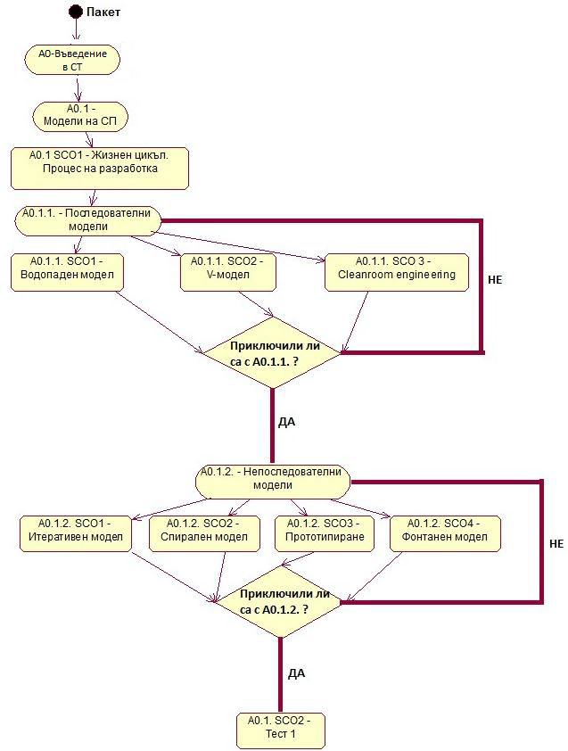
Structure of the SE e-textbook
Components that build the lesson;
Order of the component execution;
Go ahead conditions
Notes:
This is the first step from the development process. To create the structure of the SE e-textbook we used activity diagrams. On the activity diagram we define the components that build the lesson. Act5ivity states correspond to aggregations, and states correspond to SCOs. Transitions between components present order of the component execution. And decisions are go ahead conditions.
This diagram is the first lesson in the textbook “Introduction in SE” We have one subagregation „Software development process models“. It has one SCO ” Software development process ” and two subagregations “linear models”, and “no linear models” and so on. It is important to note that there is no matter order of the execution of the SCOs in them. In the end of the each lesson there is a control test – in our lesson it is SCO 2 from Agregation A0.1.

Slide 7
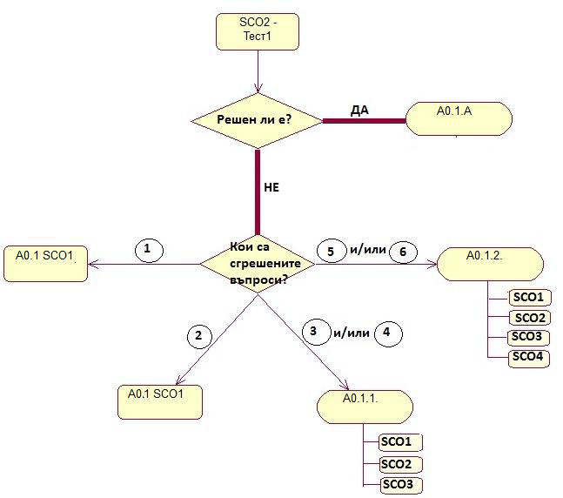
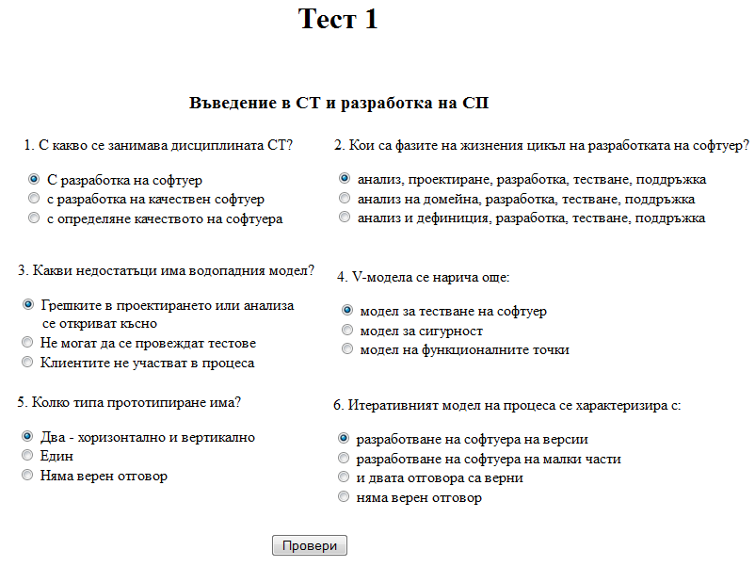
Navigation scheme
Notes:
This is the first test about the first lesson. And navigation scheme for it. This navigation scheme shows what happen when the answers of the different questions are wrong. For example for the first test: When the answer of the question one is wrong then SCORM player will return the student in A0.1 SCO1
This navigation make the e-learning process adaptiv.

Slide 8
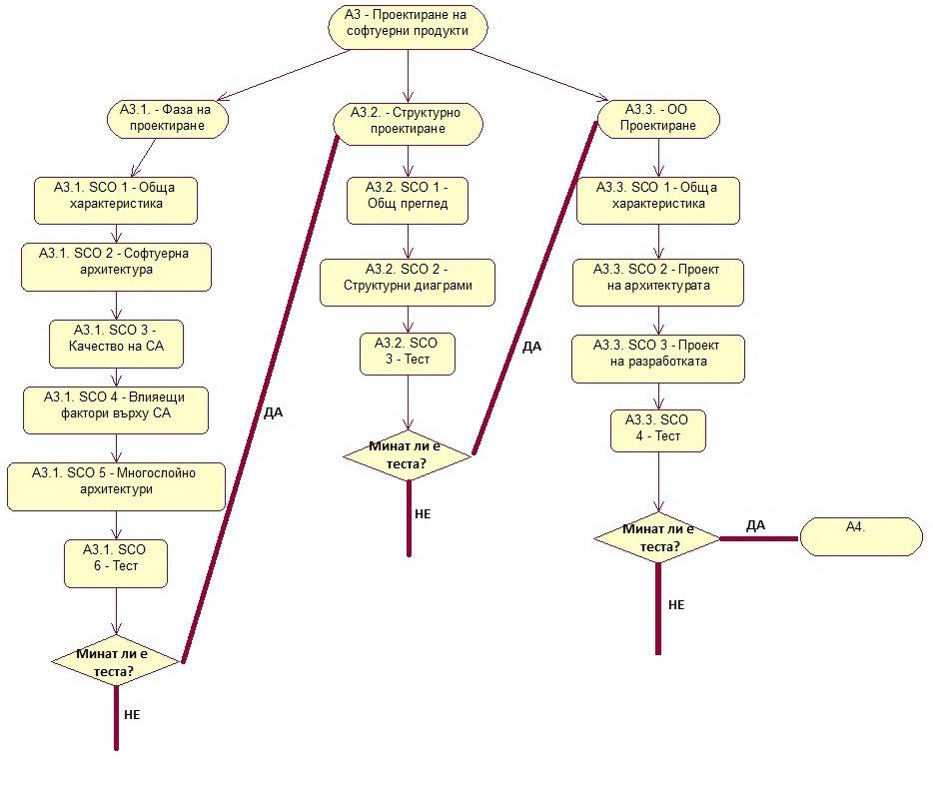
Notes:
This is another scheme of the SCORM lessons. We have all schemes and their descriptions of the e-textbook as a documentation.

Slide 9
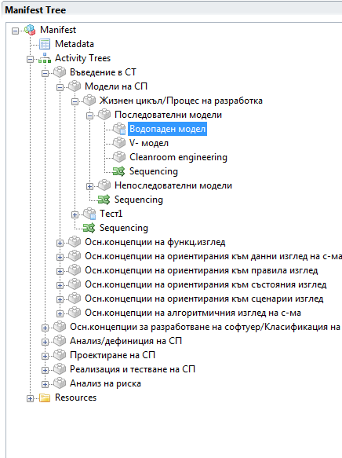
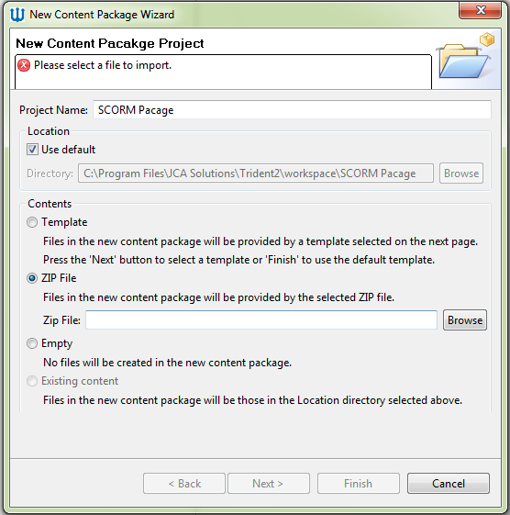
Design and realization of the e-textbook in SCORM editor
All e-learning components
Execution order of the components
All resource files associated with e-learning components
Notes:
On this slide is presented manifest file of the e-textbook. It consists:

Slide 10
Implementation Tools
Trident IDE 2.0
HTML5, CSS3
XML
JavaScript, Bootstrap
DeLC SCORM Player

Slide 11
E-textbook in Software engineering

Slide 12
Advantages of the e-textbook
Free for our students
The lecturer can observe the students’ progress (thru DeLC)
Blended learning:
e-Textbook has to be passed before the final exam
The lecturer can receive different statistics:
Which part of the book is most ease/difficult (based on the failed internal tests)
Which part of the book is most ease/difficult per student
… (ideas?)
Notes:
And in the end of my presentation I would like to present some of the advantages of the e-textbook

